Slide 1
Fruiting Position Value Georgia 2019 (3 location average)
$1
$3
22
21
$5
$10
20
Fruiting Location | Value
1st Positions | 72%
2nd Positions | 18%
3rd Positions | 5%
Vegetative | 5%
Nodes ≤10 | 60%
Nodes 11-15 | 31%
Nodes ≥ 16 | 9%
19
$11
$2
$19
18
17
$28
$2
$1
$3
$33
16
$46
15
$11
$2
$47
$1
$12
14
$47
13
$13
$4
$46
$61
$8
$13
12
$67
11
$21
$4
$9
$22
10
$72
9
$24
$6
$22
$70
8
$4
$56
7
$13
$1
$3
$6
$27
6
5
$9
$1
4
Whitaker 2019

Slide 2
Fruiting Position Value Georgia 2019 (3 location average)
$1
$3
22
21
$5
$10
20
Fruiting Location | Value
1st Positions | 72%
2nd Positions | 18%
3rd Positions | 5%
Vegetative | 5%
Nodes ≤10 | 60%
Nodes 11-15 | 31%
Nodes ≥ 16 | 9%
19
$11
$2
$19
18
17
$28
$2
$1
$3
$33
16
$46
15
$11
$2
$47
$1
$12
14
$47
13
$13
$4
$46
$61
$8
$13
12
$67
11
$21
$4
$9
$22
10
$72
9
$24
$6
$22
$70
8
$4
$56
7
$13
$1
$3
$6
$27
6
5
$9
$1
4
Whitaker 2019
Whitaker 2019

Slide 3
Fruiting Position Value Georgia 2019 (3 location average)
$1
$3
22
21
$5
$10
20
19
$11
$2
$19
18
17
$28
$2
$1
$3
$33
16
$46
15
$11
$2
$47
$1
$12
14
$47
13
$13
$4
$46
$61
$8
$13
12
$67
11
$21
$4
$9
$22
10
$72
9
$24
$6
$22
$70
8
$4
$56
7
$13
$1
$3
$6
$27
6
5
$9
$1
4
Whitaker 2019
Whitaker 2019

Slide 4
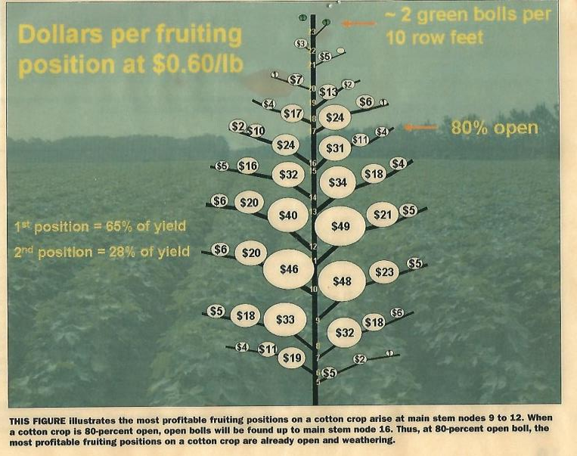

Slide 5
Fruiting Position Value Georgia 2019 (3 location average)
2019 (Whitaker)
2006 (Bednarz)

Slide 6
Fruiting Position Value Georgia 2019 (3 location average)
Fruiting Location | 2006 | 2019
1st Positions | 64% | 72%
2nd Positions | 28% | 18%
3rd Positions | 8% | 5%
Vegetative | na | 5%
Nodes ≤10 | 42% | 60%
Nodes 11-15 | 41% | 31%
Nodes ≥ 16 | 17% | 9%

Slide 7
Fruiting Position Value Georgia 2019 (3 location average)

Slide 8
Fruiting Position Value Georgia 2019 (3 location average)

Slide 9
3 Location Average
Georgia 2019
$1
$3
22
21
$5
$10
20
19
$11
$2
$19
18
17
$28
$2
$1
$3
$33
16
$46
15
$11
$2
$47
$1
$12
14
$47
13
$13
$4
$46
$61
$8
$13
12
$67
11
$21
$4
$9
$22
10
$72
9
$24
$6
$22
$70
8
$4
$56
7
$13
$1
$3
$6
$27
6
5
$9
$1
4
Whitaker 2019

